Slide 1
Sun Life Next Best Offer – NBO
ATG Fast Path/PAA/RTAB/ETAB Presentation
Template Version – March 2023

Slide 2
Sun Life Next Best Offer – NBO
Project Overview
Background Sun Life Asia wants to – Improve their cross-sell / up-sell strategy Build a comprehensive Next Best Offer (NBO) framework Develop an automated ML based platform and comprehensive Next Best Offer (NBO) product for resell and bank partner data modules Solution Overview An AIML product with a Web UI for ease of access to various users. The pipeline will include – 2 Champion Models Data Generation – Customer 360 Product – Web Interface Key Goals Recommend Next Best Offer for every customer at the right frequency Product with interfaces to various downstream applications and digital enabled tools that can be deployed across geographies For Business users – Champion model profiling across C360 attributes like Age groups etc. For Data Science users – Champion model performance and stability output, ability to select attributes from C360 attributes and retrain the champion model Connectors to identified activation platform
Financial Overview – Rachit/Celia – TBD
Include summary of Financial requirements; Indicate if you seeking financial approval; Must include any future state Operational cost considerations NOTE: Itemize and separate for any internal and external cost
Cost Description | Project Cost
Total Project Cost
Domain Certification Overview
Certification Status = Approved, In-Progress or Not Required
Domain Certification Area | Certifier Name | Certification Status
Application Architecture
InfoSec (ISRA Number)
Etc…

Slide 3










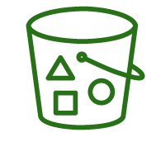







High Level Physical Architecture Diagram
T
R
A
N
S
I
T
I
O
N
VPN (TBD)
Singapore (ap-southeast-1)
VPC
AZ-1
Lambda
Private Subnet
Private Subnet
Security Group 1
Security Group 2
KMS
MS HIS Server
Transit Gateway
Web Application Server
Lambda
Processed datasets, C360, model artifacts, etc.
PostgreSQL – RDS
CORP / INTERNAL (1-7 - TBD)
T
R
U
S
T
E
D
Private Subnet
Customer Gateway
Direct Connect
Direct Connect Gateway
Security Group 3
EMR Scope
Flat File Datasets from S3
Cloud watch
DIZ (16 - TBD)
T
R
U
S
T
E
D
ML Modules – Scheduled and On-Demand
ADR
Auto-Scaling Persistent
EMR Cluster
Sample details
Oracle Database 12c
(sv8115.ph.sunlife)
DIZ(16?)
Digital Signature DB
PDRSS106:RSSD06
Secrets Manager

Slide 4


Logical Architecture Diagram
Frontend for User Interaction
Backend APIs
Processing Layer
Source of Raw Datasets
A1
User Inputs – Model, KPI filters
Visualization Module
Data Sources
A
PostgreSQL
BiDA User
AWS S3
Model Summary, Performance, Trends, Demographics, Statistics, etc.
Fetch Filtered Data
A3
A2
ADR
B1
User Inputs – Dataset, transformations
B
ETL Module
B3
Transformed dataset,
Updated C360
ML Engine
On demand +
Periodic Access
ETL Processing
B2
1
Sign In
C1
User Inputs Threshold for Correlation values & ANOVA Scores, Feature transformations, model parameters
C2
Model Training
Z
2
C
ML Training Module
C3
Model Summary, Performance, Avg. Metrics Value
User Authorization
Data Science User
Authentication
D
Scoring
D1
User Inputs – Model, Input Features, Dataset
D2
Scores input dataset
D3
Recommendations
E
Scheduler
E1
Add models for
Regular Predictions

Slide 5

System Diagram (Context)
Model Development
Develop on top of existing model
Static & Dynamic Client Data
ADR & Flat Files
A platform for
Raw data
to generate feature set
Utilizes trained production model for customization & model development
NBO Product
An ML Product with Web Application for Interaction
Performance Reports
Product, & Market
Analytical reports
Product demographics, KPI trends
Data Science Users
Scheduler
Monthly refresh of
*Customer 360 dataset*,
Model scores/predictions
Recommendations
Data centric – Resell strategies
Potential clients, relevant products & pitch specifics
Admin Users
Add models
to the schedule
Pipeline extension using
Evidence based predictions
BiDA Users
BiDA – Business Analytics
*Customer 360 dataset is a by product with an exhaustive set of 400+ features
Color code diagram which parts are new changes vs. existing
No Change
New
Change
Not In Scope
C4 Model Diagram – Level 1 System Context

Slide 6
System Diagram (Container)
Static & Dynamic Client Data
Flat Files
ADR
Raw data
to generate feature set
NBO Product
An ML Product with Web Application for Interaction
ML Product
DS Users
Business Value
BiDA Users
Model Development
Performance Reports
Features – ETL
Model Training
Enables Model Development
Analytical reports
Market Performance
Product Performance
Pipeline
Admin Users
Scheduler – Monthly
Recommendations
Pipeline extension using
Evidence based predictions
Feature Set – C360
Model Scoring
Potential Clients
Product Recommendations
Color code diagram which parts are new changes vs. existing
No Change
New
Change
Not In Scope
C4 Model Diagram – Level 2 Container

Slide 7
System Diagram (Component)
ML Product
DS Users
Static & Dynamic Client Data
Model Development
CSVs from SharePoint
CSVs from AWS S3
ADR
Business Value
BiDA Users
Performance Reports
Features – ETL
Model Training
Raw data to generate feature set
Market Performance
Product Performance
Descriptive statistics
Feature Reduction & Selection
Enables Model Development
Presents an interactive dashboard
Client Conversion
Product – Purchased vs Recommended statistic
Data Transformations
Engineered features for training
Feature Transformation
NBO Product
An ML Product with Web Application for Interaction
Raw to Transformed features
Data Merge
(Join datasets)
Model Parameter Tuning
Features into model scores
AFYP
Investment
% Uplift Trend in KPIs
Feature Engineering
Model training & evaluation
Pipeline
Admin Users
Scheduler (Monthly)
Recommendations
Feature Set – C360
Model Scoring
Pipeline extension using
Generates predictions as actions
Potential Clients
Product Recommendations
Base Features
Champion Production Model
Derived Features
Decile wise distribution
Product Group Level
User Scheduled Model
Markers
Color code diagram which parts are new changes vs. existing
No Change
New
Change
Not In Scope
C4 Model Diagram – Level 2 Container

Slide 8
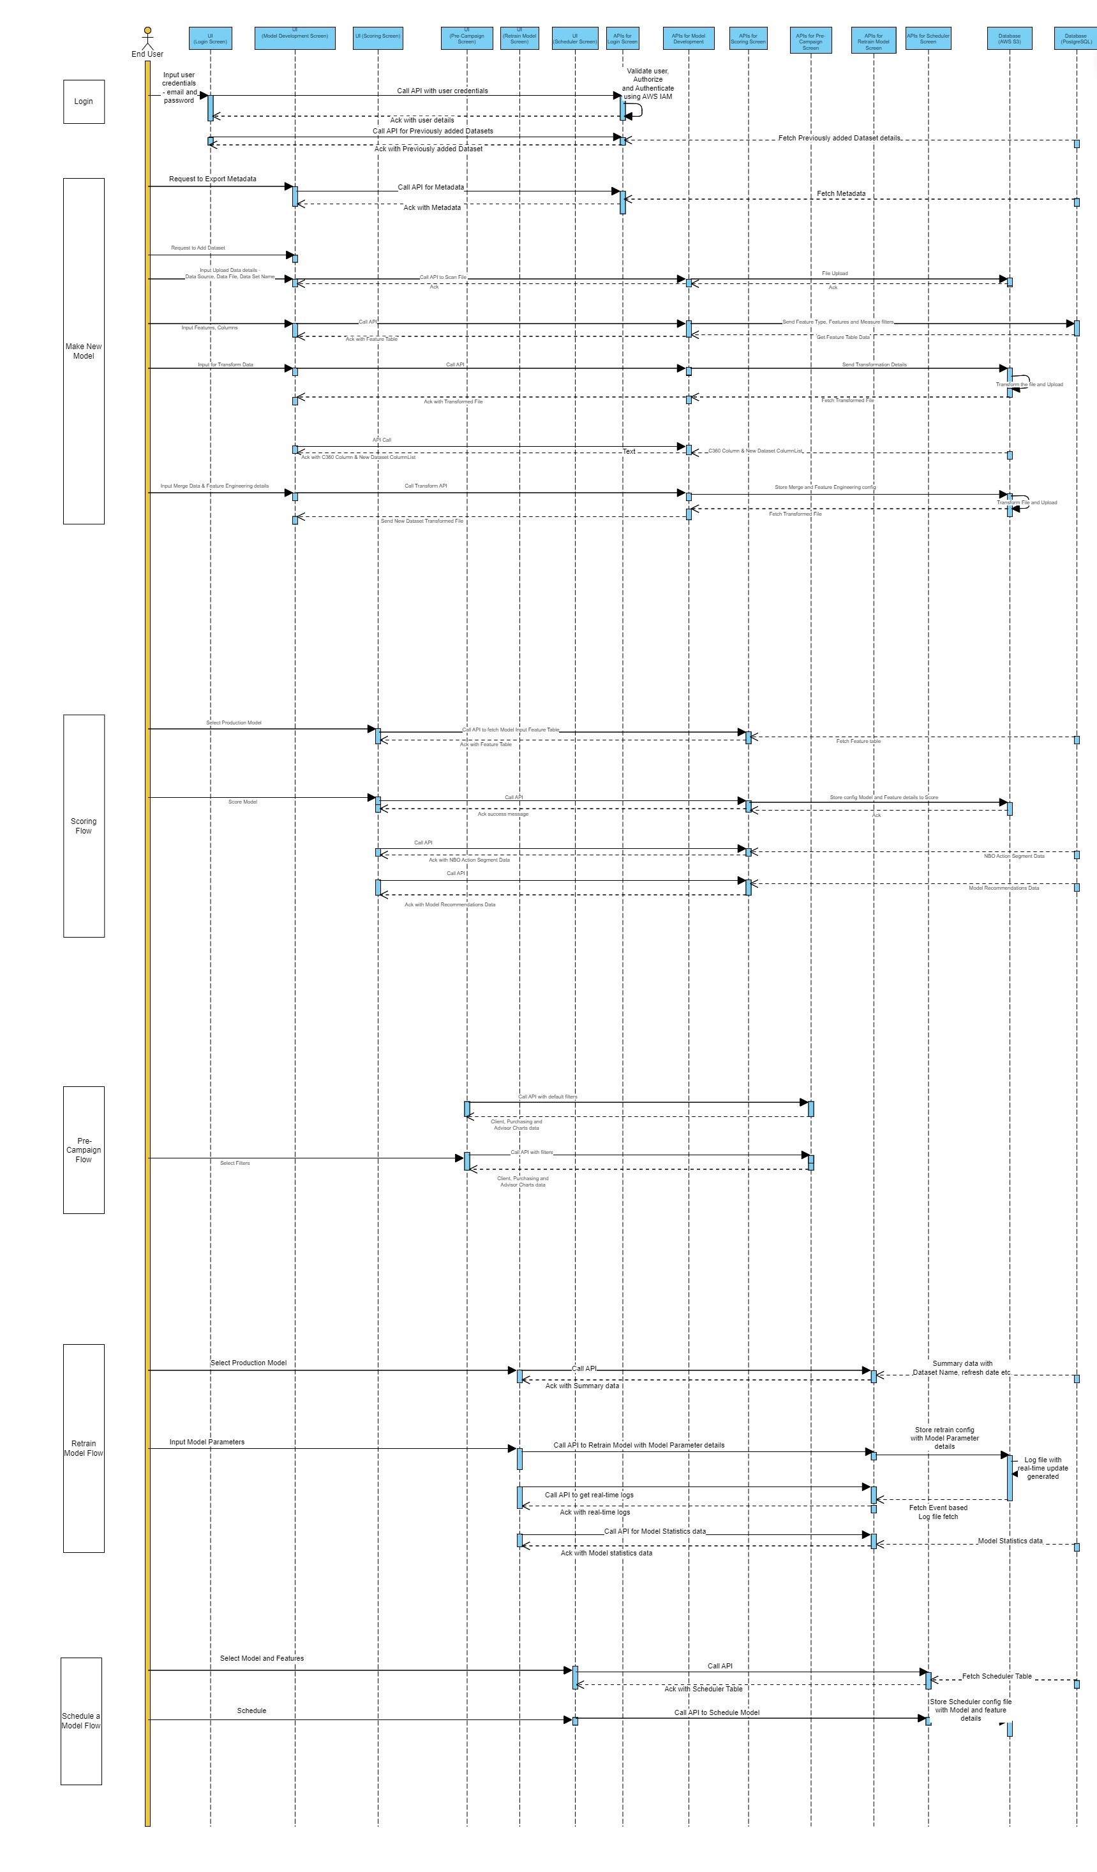
Sequence Diagram
Color code diagram which parts are new changes vs. existing
No Change
New
Change
Not In Scope
C4 Model Diagram – Level 3 Component

Slide 9
Technology Stack
Component | Solution/ Vendor | SLF Approved Version | Remarks
Version Control | Bitbucket
Front End | ReactJs
Back End | Node.js
AWS Networking Services | Direct Connect, Customer Gateway, Transit Gateway, VPC, Subnets, Security Groups VPN and DNS will be created/provided by Sun Life For Scalability in future: ALB / NLB
AWS Processing Services | EC2, EMR, Lambda
AWS Storage Services | RDS, S3
Authentication Mechanism | 1 set of credentials per user type maintained in AWS – accessible to Admin user
Security | ACM (certificate manager), KMS, IAM, Identity provider (SAML) SSM parameter store – secret manager
Supporting Services | Cloud Watch
CICD | AWS Code Pipeline – to be discussed

Slide 10
Appendix & Supplemental Slides

Slide 11
Appendix
Topic | Query / Comments
Available AWS Infrastructure | Network setup for access over intranet – e.g.: virtual private gateway, etc. Direct Connect is established between Sun Life and AWS Singapore region.
AWS Infrastructure Provisioning | Team responsible for provisioning / setting up initial AWS infrastructure – e.g.: the networking services like VPC, Security Groups Sun Life or Admin access to Fractal Team?
CICD Pipeline | Is CICD setup available? AWS Code Pipeline

Slide 12
Supplemental Slide

